Slide 1

Advanced Load Balancing

Slide 2
Databases LAB - 1
Setup and configure an ALB
Notes:
=========Lambda Code===========
import json
def lambda_handler(event, context):
print("Hello! From Lambda")
resp = {
"statusCode": 200,
"headers": {
"Access-Control-Allow-Origin": "*",
},
"body": json.dumps("This is not a server")
}
return resp
==========HTML Code===========
<html>
<script>
function myFunction() {
var xhttp = new XMLHttpRequest();
xhttp.onreadystatechange = function() {
if (this.readyState == 4 && this.status == 200) {
document.getElementById("my-demo").innerHTML = this.responseText;
}
};
xhttp.open("GET", “YOUR-API-GATEWAY-LINK", true);
xhttp.send();
}
</script>
<body>
<div align="center">
<br>
<br>
<br>
<br>
<h1>Hello <span id="my-demo">Serverless Website!</span></h1>
<button onclick="myFunction()">Click me</button>
<br>
<img src="https://s3.amazonaws.com/acloudguru-opsworkslab-donotdelete/ACG_Austin.JPG">
</div>
</body>
</html>

Slide 3
Applications Advanced Concepts
Sticky Sessions: binds a user’s session to a specific EC2 instance while using Classic Load Balancers, i.e. any request from that user always goes to the same instance of EC2
For Application Load Balancers, Sticky Sessions can be configured at Target Group Level
Cross Zone Load Balancing: Enables Load balancing across EC2 instances across regions, e.g. when using Route 53 like they were part of one pool.
Path Patters: Route requests to specific destinations based on URL path

Slide 4
Databases LAB - 2
Launch Configurations & Autoscaling
Go to EC2 > Launch Configurations
Hit Create Launch Configuration,
Select Amazon Linux AMI & t2.micro, hit next
Give name
Give any IAM role
Give a bootstrap script
Go to Security Group, select a DMZ security group
Hit create and launch
Next Hit Create an Autoscaling Group
Give any name
Group Size – 3 instances
Select the VPC
Select the subnet, hit next
Select Use scaling policies to adjust the capacity of this group
Change the configuration to between 3 & 6 instances
Select Average CPU Utilisation 10%
Instances need 60 seconds to warm up
Add tag and create the Autoscaling group
Terminate one instance
Run a load balancer test
Notes:
#!/bin/bash
yum update –y
yum install httpd –y
service httpd start
chkconfig httpd on
cd /var/www/html
Echo “<html><h1>Say hello to my little EC2 Fleet</h1></html>” >index.html

Slide 5
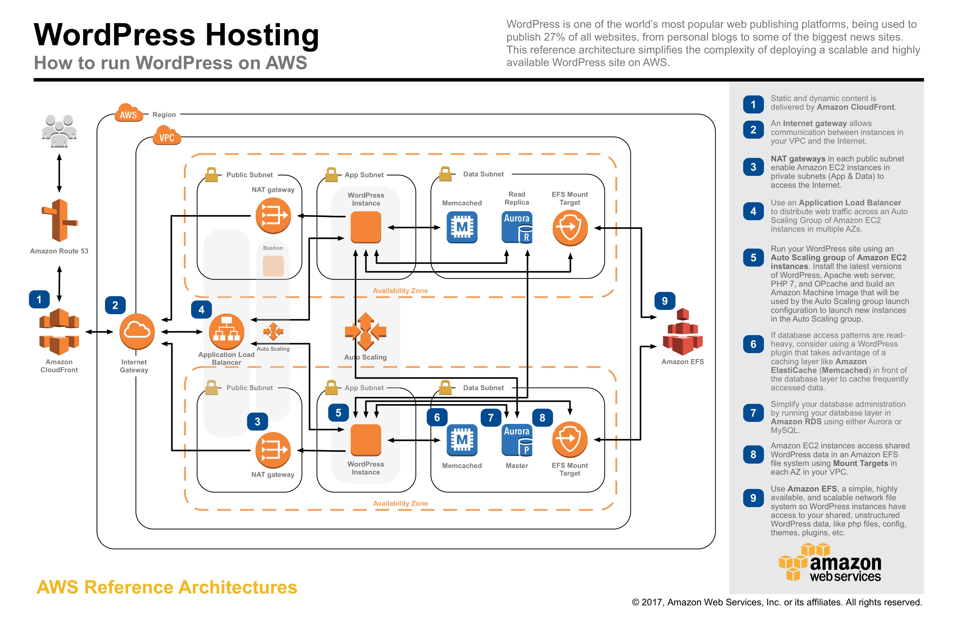
Applications Fault Tolerant Architecture

Slide 6
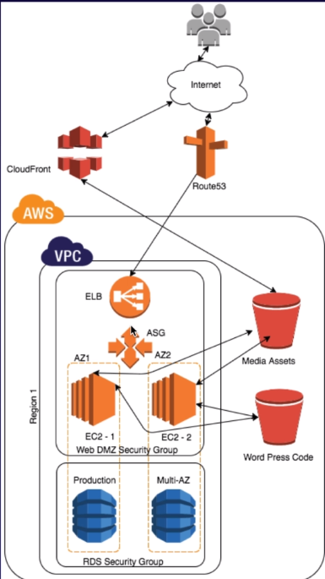
Databases LAB - 2
Creating a Fault Tolerant WordPress Website
Create an S3 bucket – to save WP code
Create an S3 bucket – to save media
Create a CloudFront distribution
Choose Web distribution
Origin name should be S3 bucket to save media
Create RDS Instances
Create a Security Group
RDS Security should have port 3306 open to DMZ Security group
Go to RDS -> Choose MySQL
Choose Dev/Test – MySQL
Create a replica in different zone
Change the Storage to General Purpose to SSD
Enter DB details
Choose an existing VPC security Group and choose the RDS Security Group
Hit Create DB
Create an IAM Role for EC2 to talk to S3
Go to IAM> Role>Create role
Search and select AmazonS3FullAccess
Add Tags
Given Name
Provision EC2 Instance
Paste the bootstrap script
Give a unique name – i.e. Golden Image
Select DMZ security group
Then Launch
Notes:
#!/bin/bash
yum update -y
yum install httpd php php-mysql -y
cd /var/www/html
echo "healthy" > healthy.html
wget https://wordpress.org/latest.tar.gz
tar -xzf latest.tar.gz
cp -r wordpress/* /var/www/html/
rm -rf wordpress
rm -rf latest.tar.gz
chmod -R 755 wp-content
chown -R apache:apache wp-content
wget https://s3.amazonaws.com/bucketforwordpresslab-donotdelete/htaccess.txt
mv htaccess.txt .htaccess
service httpd start
chkconfig httpd on

Slide 7
Databases LAB – 2b
Setup EC2
ssh into the EC2 instance
Notes:
#!/bin/bash
yum update –y
yum install httpd –y
service httpd start
chkconfig httpd on
cd /var/www/html
Echo “<html><h1>Say hello to my little EC2 Fleet</h1></html>” >index.html

